Slide 1

Building a game with logic

Slide 2
Purpose
Recognizing logic in code
To combine logic with writing code

Slide 3
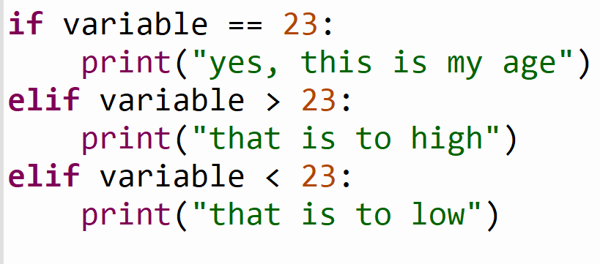
Example

Slide 4
X = 600
Y = 800
We have a grid of 800x600

Slide 5
X = 600
50
50
Y = 800
We have a player of 50x50

Slide 6
X = 600
Y = 800
We want to place the player in the middle of the screen

Slide 7
X = 600
Y = 800
If we place the player on (0,0) it will be in the bottom left corner

Slide 8
X = 600
Y = 800
What vector is needed to get it in the middle?
Player = (a,b)

Slide 9
X = 600
Y = 800
A = (x / 2) – 25 || A = (600 / 2) – 25
B = (y / 2) – 25 || B = (800 / 2) – 25
(275,375)

Slide 10
Player = (275,375)
X = 600
Y = 800
No we want to move. If we press ‘right arrow’,
what should happen with Player?

Slide 11
Player = (275,375)
X = 600
Y = 800
No we want to move. If we press ‘right arrow’,
what should happen with Player?
Player.y = Player.y + 1 || Player.y = 375 + 1

Slide 12
Player = (275,375)
X = 600
Y = 800
If we press ‘left arrow’,
what should happen with Player?

Slide 13
Player = (275,375)
X = 600
Y = 800
If we press ‘left arrow’,
what should happen with Player?
Player.y = Player.y - 1 || Player.y = 375 - 1

Slide 14
Player = (275,375)
X = 600
Y = 800
If we press or ‘up arrow’,
what should happen with Player?

Slide 15
Player = (275,375)
X = 600
Y = 800
If we press ‘up arrow’,
what should happen with Player?
Player.x = Player.x + 1 || Player.x = 275 + 1

Slide 16
Player = (275,375)
X = 600
Y = 800
If we press ‘down arrow’,
what should happen with Player?

Slide 17
Player = (275,375)
X = 600
Y = 800
If we press ‘down arrow’,
what should happen with Player?
Player.x = Player.x - 1 || Player.x = 275 - 1

Slide 18
Player = (275,375)
X = 600
Y = 800
If we hold ‘down arrow’ the block will keep moving down
Also out of the screen

Slide 19
Player = (275,375)
X = 600
Y = 800
If we hold ‘down arrow’ the block will keep moving down
So how do we make it stop at the edge?

Slide 20
Player = (275,375)
X = 600
Y = 800
Now do the same for top, left and right border

Slide 21
Player = (275,375)
X = 600
25
10
Y = 800
If we press ‘W’ we want to shoot a projectile on what position is
needed to let it start from the middle of the player?

Slide 22
Player = (275,375)
X = 50
25
10
Y = 50
Now we do the position on the y axis, for this we need the position
of the player on this axis, which is 375, we need the width
of the player which is 50 and we need the width of the projectile which is 10
The position will be: 275 + (50/2) = 300

Slide 23
Player = (275,375)
X = 50
25
10
Y = 50
First we do the position on the x axis, for this we need the position
of the player on this axis, which is 275 and we need the height
of the player which is 50.
The position will be: 375 + (50/2) – (10/2) = 395

Slide 24
Purpose
Recognizing logic in code
To combine logic with writing code

Slide 25
What is your opinion about this lesson?

